Slide 1
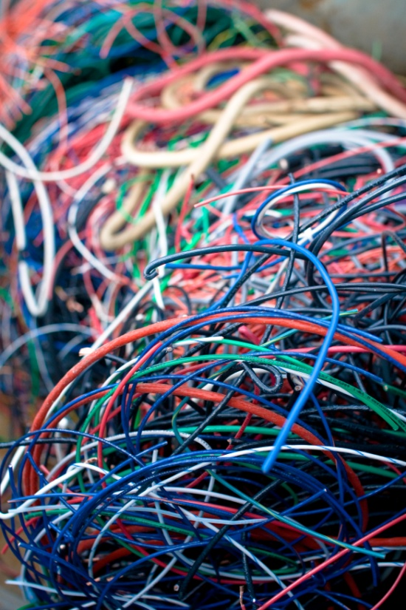
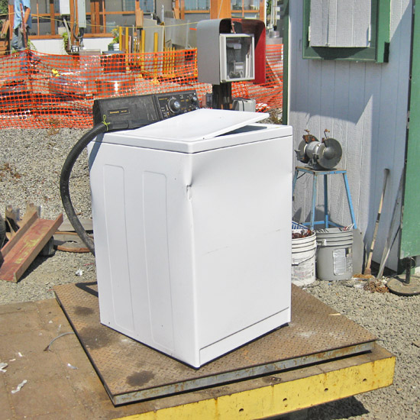
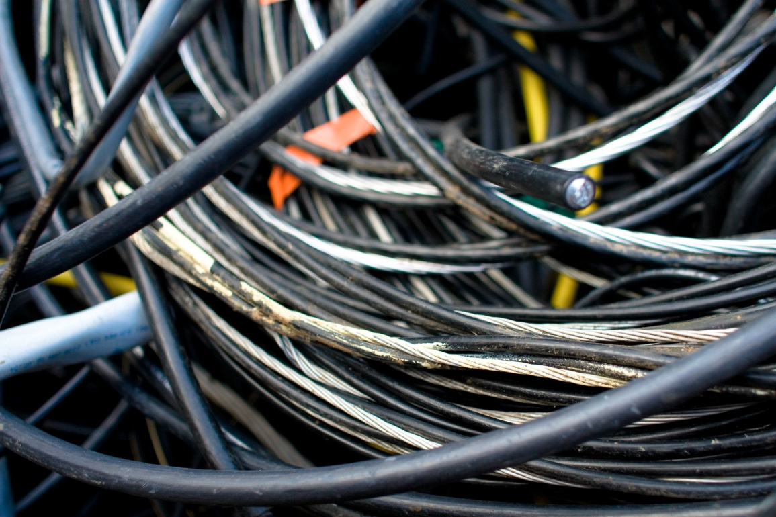
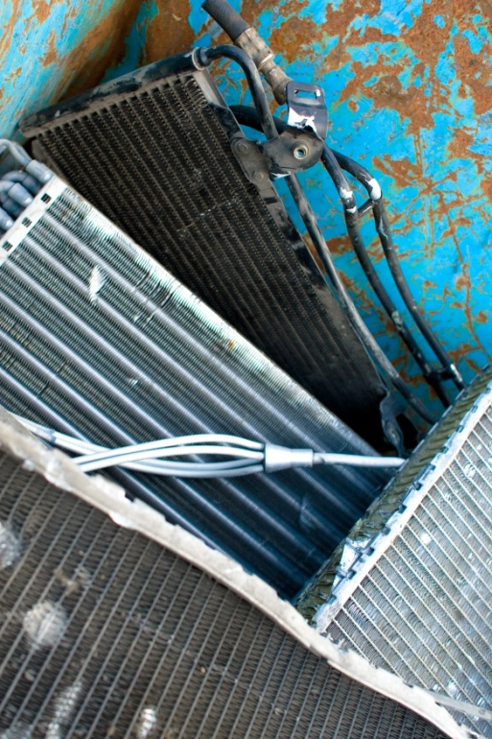
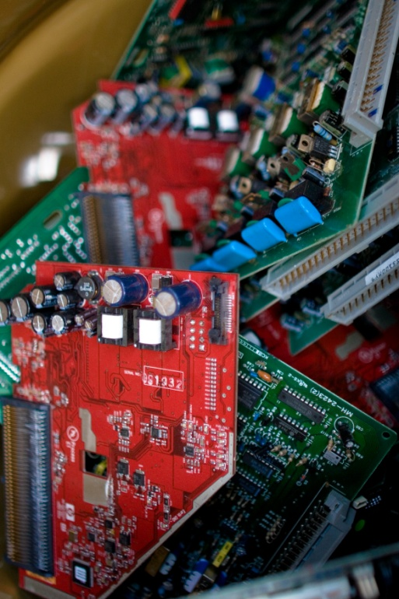
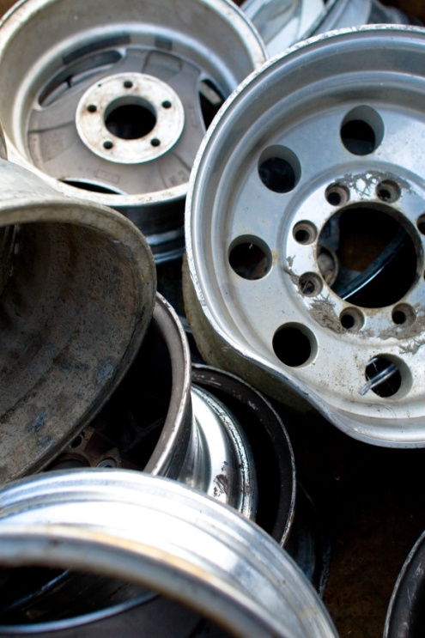
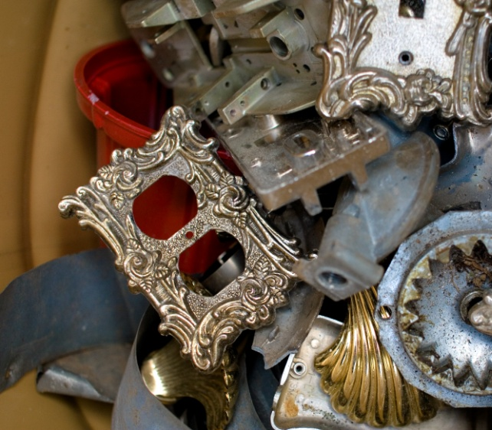
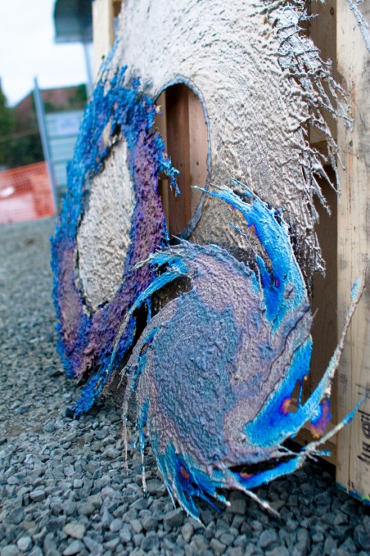
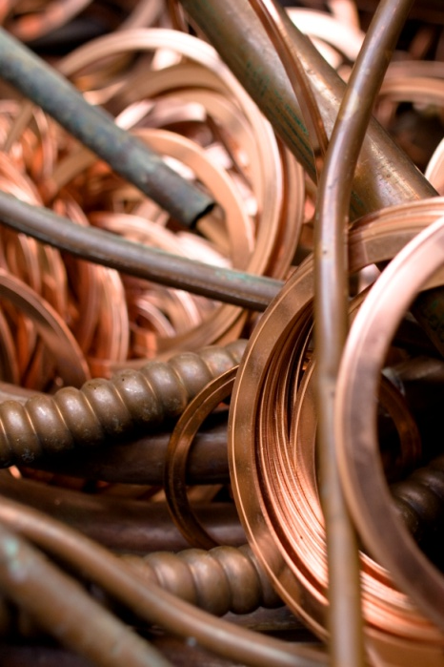
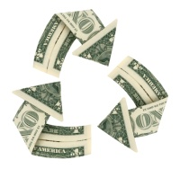
(Insert Your Event) Fundraiser
Let us help you clean up and recycle scrap metals and appliances from a cluttered shop, garage or property.
The funds raised will be used to support (Insert Your Event)!
We will bring the necessary equipment & manpower; you supply the old scrap metal items.

Slide 2
(Insert Your Event) Fundraiser
Some items that can be recycled are:
Appliances, Copper, Brass, Aluminum, Steel, Gutters, BBQs, Electric Motors, Window Frames, Wood Stoves, & MORE!
Please contact (Insert Coordinator’s Name) at (Insert Coordinator’s Contact Information) for more details or to schedule a pick up date and time.
Thank you for your support and God Bless You!

